Slide 1
Relevance of Reading Shakespeare in Modern India
Uddalak Dutta,
Department of English,
22.08.2019.

Slide 2
Unprecedented Popularity
Shakespeare – the world’s most popular Brit – represents a rare breed of humans who seem to have achieved figurative immortality.
Shakespeare’s complete works continues to be the world’s favourite secular reading.
His works were introduced to Indians as part of the colonial scheme to convince the natives about the superiority of English culture.
Shakespeare’s works formed part of academic study in universities in India even before they achieved a similar status in the land of his birth.
He continues to feature prominently on school, college and university syllabi even after four centuries since his demise and seven decades since Independence.

Slide 3
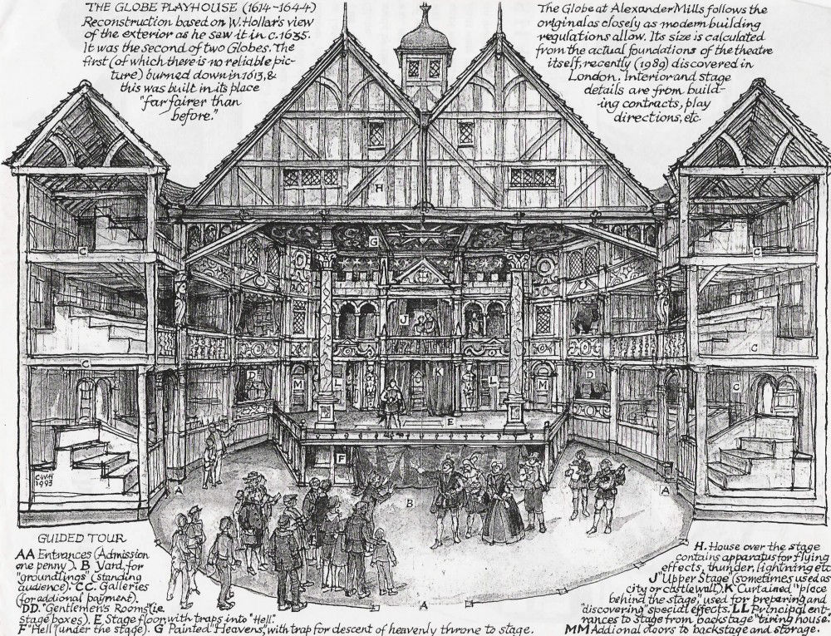
The Elizabethan Theatre

Slide 4
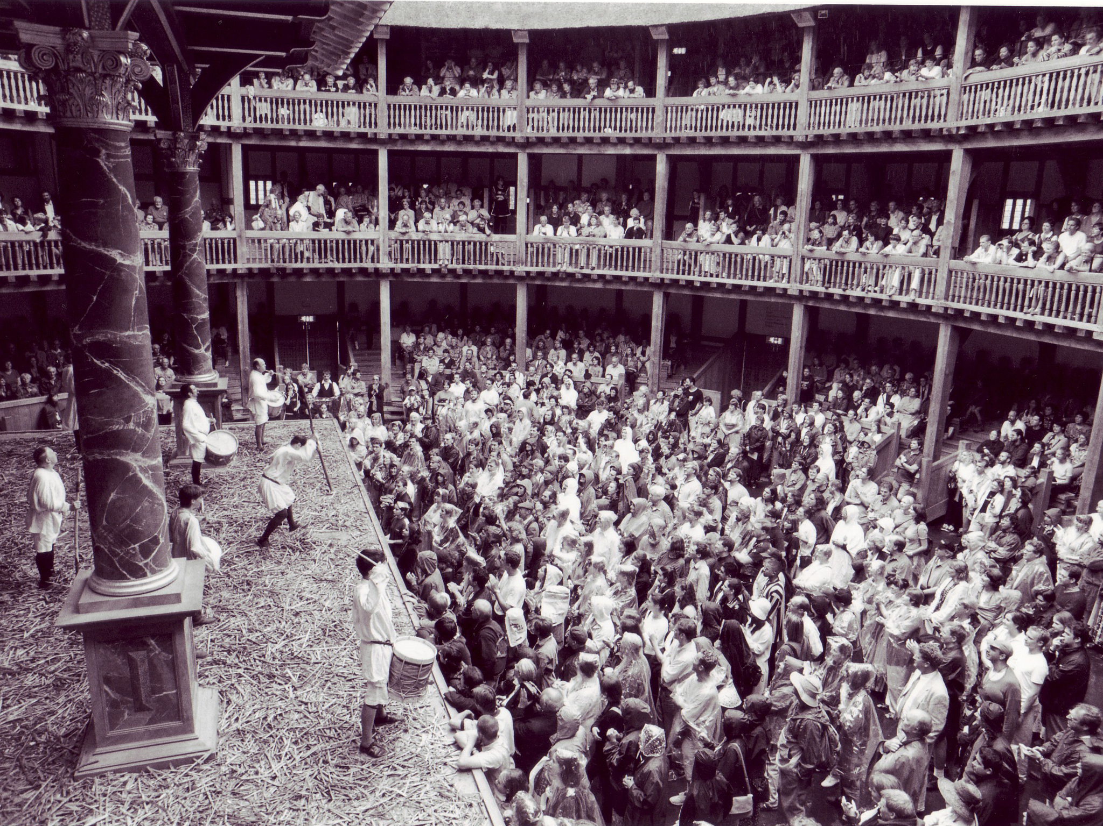

Slide 5
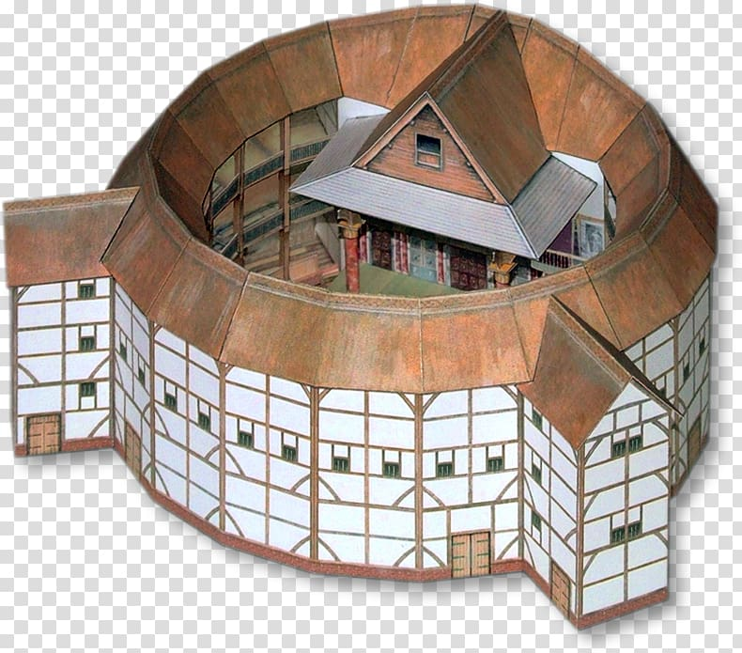

Slide 6
The Elizabethan playhouse was very different from the modern auditorium.
The stage was open to the sky, which meant plays would have to be suspended for rain, storm or similar natural interruptions.
Performances would often run for five or six hours; generally, through the day.
The actor had to depend solely on his body and his voice to hold the attention of the audience, who thronged to these productions as theatre was the only means of entertainment for them.
Shakespeare’s audience was a motley mixture which defied the strictures of the class-ridden Elizabethan society.
Aristocrats, traders, the nouveau riche, and other “respectable” sections of the population were seen along with so-called “anti-social” elements like criminals and prostitutes.
Separate seating arrangements were made depending upon one’s social class and wealth.

Slide 7
The “lower classes”, who could not afford seats, would stand around the stage to watch plays.
Most of the sophisticated aristocrats could not stand the rising importance of the groundlings in society. Skirmishes, and even fights, were commonplace.
Members of the audience could behave as they pleased, once they were inside the theatre.

Slide 8
Shakespeare’s theatre and the Jatra of Bengal: close “cousins”
Like in the Elizabethan theatre, Jatra performances run into seven or eight hours, often through the night.
They are open-air affairs which work with crude stage machinery.
The motley spectators, predominantly rural, often prove to be chaotic. They shout their appreciation or disapproval of an actor loud enough to be heard on stage, munch nuts, chat with friends, troop in or out of a performance as they wish, and even fall asleep!
The imposed discipline in a modern urban theatre house is alien to the atmosphere of Jatra, just as it was unimaginable in Shakespeare’s time.

Slide 9
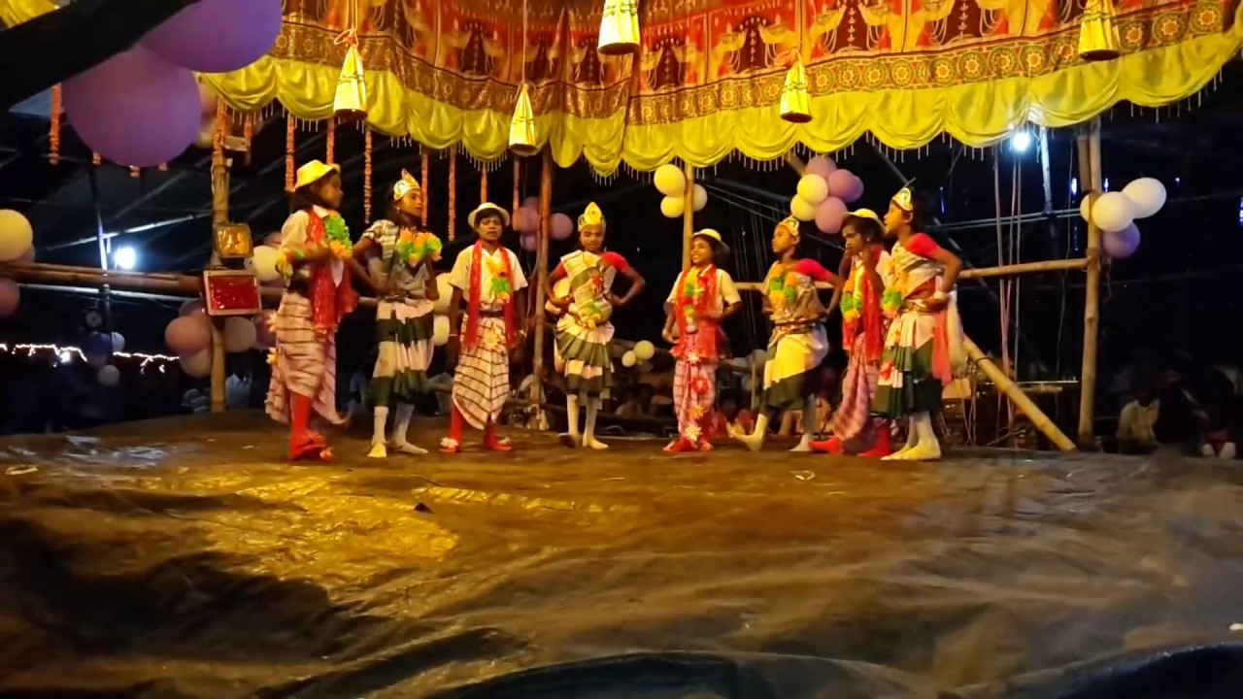
A traditional Jatra sequence:

Slide 10
Distinct similarities may be identified in terms of technique in Shakespeare’s theatre and the traditional Jatra form:
The primary objective in both cases was entertainment.
The abundance of ghosts, witches, sword fights, duels, on stage – elements that greatly interested the average Elizabethan theatre goer – in Shakespeare’s plays was no accident.
Shakespeare’s actors had to exaggerate their body movements, voice and gestures in order to arrest the attention of the large, unruly crowd in the playhouse. By modern standards, most Elizabethan actors would have been guilty of “over-acting” and “melodrama”.
The presentation style popular in the Jatra is similar: “loud” costume and make-up, exaggerated body movements and dialogue delivery to the point of almost flailing limbs on stage.
The Elizabethans took keen interest in British history, and Shakespeare primarily chose the countless intrigues which marked the transfer of power in British monarchy as subject matter in his history plays . Jatras, too, traditionally draw on popular mythological tales, or the Puranas and epics.

Slide 11
The Role of the Audience:
Securing the desired impact in the battle scenes in Julius Caesar or the Storm Scenes in King Lear would have been impossible with the crude stage machinery available in Shakespeare’s day.
Jatra sets are hardly able to recreate scenes from the epics. But, this “inability” does not hinder the audience’s “acceptance” of the fiction.

Slide 12
The nature of acting suited to the Elizabethan stage and the Jatra proved to be extremely strenuous for actors. Every emotionally intense scene in Shakespeare is followed by one that is relatively “light”.
This allowed the audience as well as the actors to come to terms with the impact of the preceding scene and prepare themselves for the future upheavals in the plot. The actors could “rest” themselves to an extent in these so-called comic interludes.
Jatra plays have a similar structure, generally governed by the same principles of performance.
We have an inherent understanding of Shakespeare that is deep-rooted in our cultural ethos.

Slide 13
Subject Matter:
Shakespeare’s immortality owes itself to the universal nature of his subject matter.
First, we will take a look at his concept of political power, and try to understand the manner in which his “kings” have appealed to civilizations across the world over centuries.
It is impossible to compartmentalize the history plays on the assumption that the dramatist supports one or the other political clique. Though historical in origin, these plays are not chronicles of history in any sense of the term. The dramatist’s imagination combines with history to ensure that events and characters described in the plays are individualized, and hence, nuanced.
The plays seem to follow a cyclic plot in the sense that they return to the point of origin at the end. Successive monarchies follow an unaltered pattern, beginning with a struggle for the crown or its consolidation and ending with an abrupt death of the monarch and consequent new coronation.

Slide 14
An interesting way of explaining the apparent cyclical structure of Shakespeare’s history plays is to use the metaphor of a staircase. If we imagine the throne placed at the top of a flight of stairs, and each separate stair so narrow that only one person can stand on it at a time, we understand that each step upwards consolidates the throne. Yet, a “Henry” must always push a “Richard” down in order to get to the top. The path to power is also the road to death.
In our country, each general election is marked by delirious optimism which soon fizzles out, as we are left hapless victims, praying for the next election to arrive sooner than expected, only to re-initiate the vicious cycle of assumption and abuse of power. We have little agency but to gaze helplessly at the grand staircase of power, even though our fate depends on who reaches the top.

Slide 15
Shakespeare’s universal appeal, of course, cannot be measured in terms of its topical relevance to India alone. His works seem to have foretold, or re-enacted, the human drama of existence since the beginning of time.
The plot of Macbeth, for instance, is gruesome to say the least, yet violence is made to seem “normal”. An important historical parallel in this context is the Holocaust, where the massacre of six million Jews was similarly “normalized” by the Nazis.
The unprecedented destruction caused by the Holocaust and the Second World War was potent evidence against deluded popular imagination where man was seen as the ‘quintessence of dust’. The fact that man can annihilate his brethren without the slightest provocation is evident to the post-modern consciousness. Shakespeare’s King Lear warns us about the degeneration of man into “a ruin’d piece of nature”.
The idea that man must be stripped of his apparent grandeur, and reduced to a clownish figure fit to be laughed at, gained currency with the popularity of Absurdist literature in Europe. It is evident that man does not deserve to be represented as a glorious creation of God. Our deeds have made our inherent bestiality and helplessness apparent.

Slide 16
Once we understand the universality of Shakespeare’s art, both in terms of form as well as content, it is not difficult to appreciate that we need to read Shakespeare because he talks about us, in a manner that perhaps nobody has been able to emulate in the history of our race.

Slide 17
Thank You !

